Slide 1
CLASSIFICATION OF MONOPHONIC GUITAR NOTES ACROSS STRINGS IN NOISY ENVIRONMENT
Aug 24th, 2023
Haruniya Rajan
220256861
MSc. Big Data Science
Queen Mary University of London
Supervised By
Miss Dalia Senvaityte
Department of Electronics Engineering
Queen Mary University of London

Slide 2
PROBLEM STATEMENT
Music's Universal Appeal: Music transcends cultural and geographical boundaries, with the guitar being a versatile and popular instrument across genres.
Complexity of Guitar Sounds: Understanding guitar notes is intricate due to the multifaceted nature of sounds and compositions.
Advancements in Technology: Recent developments in AI and digital technology have enabled new methods for music information retrieval, including musical note classification.
Utilizing CNNs: This project introduces a novel method using Convolutional Neural Networks and specific audio features, extracted from the GuitarSet data, to classify guitar notes.
Trade-offs in Approach: The chosen method offers higher precision but also brings complexity in feature extraction, reflecting a balance between accuracy gains and potential overfitting risks.
Notes:
jnhuj

Slide 3
DATASET INTRODUCTION
Comprehensive Collection: GuitarSet is a large collection of annotated guitar recordings, covering various playing techniques and musical genres.
Rich Annotations: The dataset includes detailed annotations such as pitch, string, and finger positions, providing a deep insight into guitar playing.
Research-Oriented: Designed for research purposes, it facilitates tasks like transcription, analysis, and synthesis in the field of music information retrieval.
Accessibility: Available for public use, GuitarSet can be accessed through its official website, promoting collaboration and innovation in music technology.

Slide 4
METHODOLOGY
Audio Data Processing : This includes audio data extraction, translation of MIDI note numbers into pitch names, segmentation, padding, and feature extraction using librosa.
Feature Engineering : Includes pitch contour analysis, spectral features extraction, and Harmonic-to-Noise Ratio (HNR) calculation.
Data Pre-processing and Analysis : Includes Feature selection, Label Encoding, Data splitting, Outlier Treatment, Standardization, Class balancing, One-hot Encoding and Data Augmentation.
Building and Tuning the Model : Includes building a CNN Model, performing Hyperparameter Tuning, Including CallBacks and Cross-Validation, Model Training and Model Evaluation.

Slide 5
AUDIO DATA PROCESSING
MIDI Translation: Conversion of MIDI note numbers into corresponding pitch names and octaves.
Audio Segmentation: Examination of each MIDI note number with start and end times, processing of six audio channels representing guitar strings, and padding if required for FFT.
Feature Extraction: Computation of spectral features using librosa, capturing both spectral and temporal characteristics of the audio signal.
Data Augmentation: Adding Gaussian noise to both the train and test sets.

Slide 6
FEATURE ENGINEERING
Pitch Contour Analysis: Insights into the pitch's central tendency and variability across strings.
Spectral Contrast: Measures the difference in amplitude between peaks and valleys in the sound spectrum.
Chroma STFT: Related to the twelve different pitch classes, capturing harmonic content.
MFCCs (Mel-frequency Cepstral Coefficients): Represents the short-term power spectrum, often used in speech and audio processing.
Spectral Centroids: Indicates where the center of mass of the spectrum is located, often related to the perceived brightness of a sound.
Harmonic-to-Noise Ratio (HNR): Separates the harmonic and percussive components, providing insights into sound quality.

Slide 7
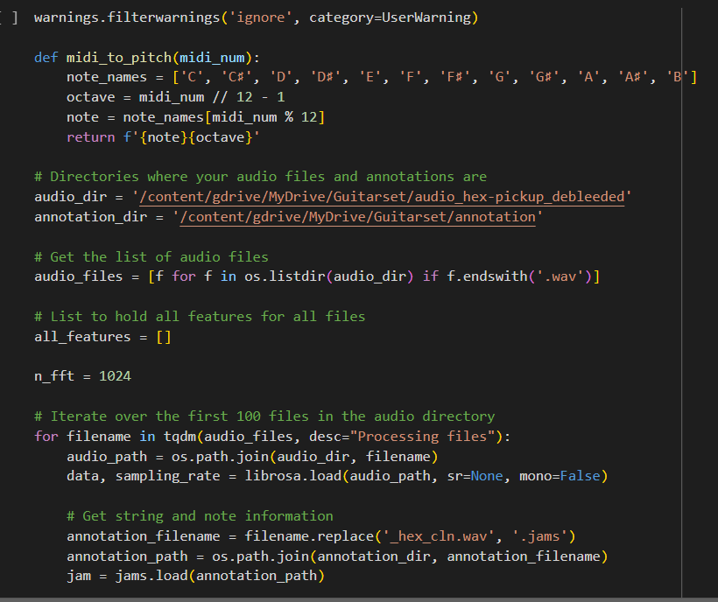
PREPROCESSING CODE DEMONSTRATION

Slide 8
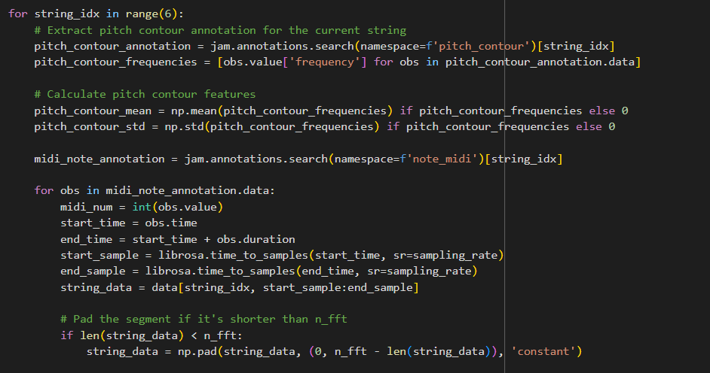

Slide 9
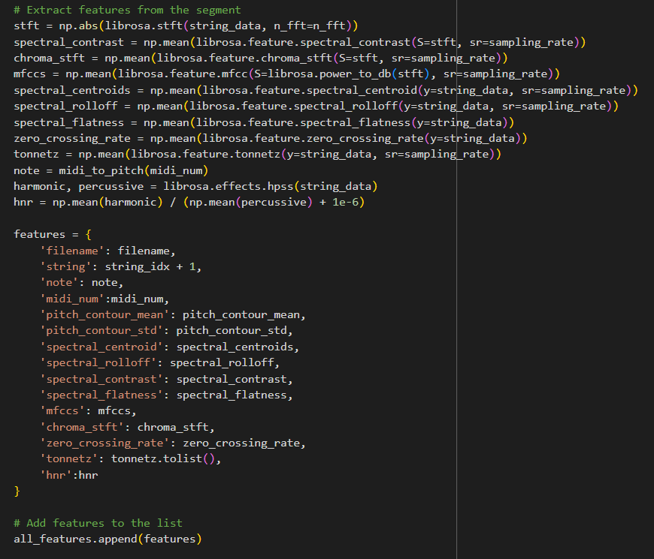

Slide 10
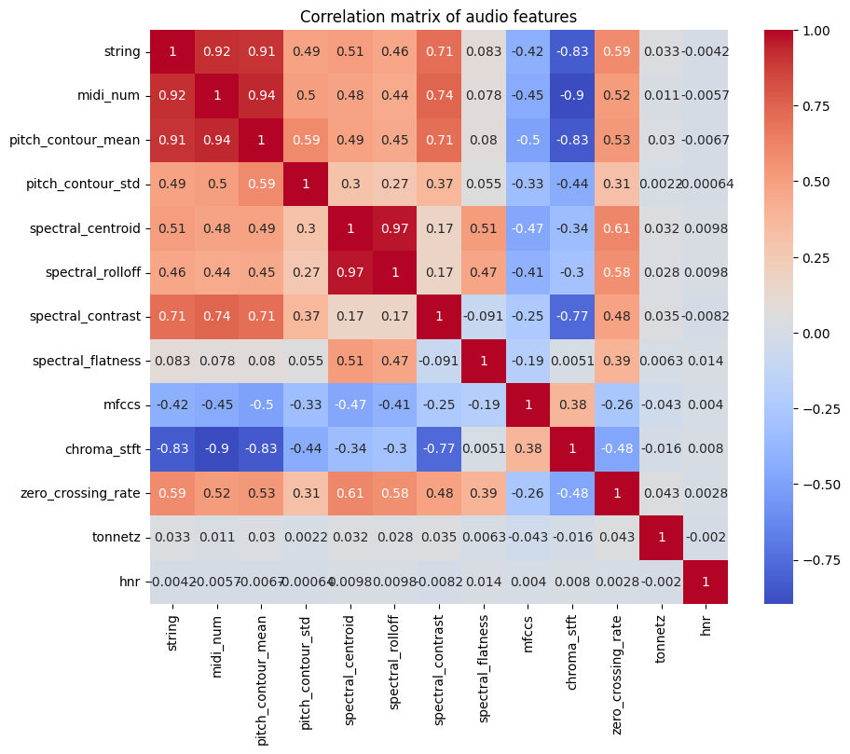
DATA PRE-PROCESSING AND ANALYSIS
Feature Selection: Inclusion of numerical features with high correlation to target variables.

Slide 11
Label Encoding & Data Splitting: Conversion of categorical labels to numerical values; 80% training, 20% validation split.
Outlier Treatment: Removal of outliers using Z-score method.
Standardization: Normalization of features to mean of 0 and standard deviation of 1.
Class Balancing: Addressing imbalance with Random Over Sampling (ROS) and one-hot encoding of class labels.
Data Augmentation: Adding Gaussian noise to both the train and test sets.

Slide 12
MODEL BUILDING
Model Architecture: The CNN model is designed using TensorFlow and Keras, comprising convolutional layers, dropout layers, flatten layers, dense layers, and output layers tailored for audio data.
Hyperparameter Tuning: Performance optimization is achieved using Keras Tuner's RandomSearch, focusing on parameters like filter numbers, kernel size, dropout rate, and learning rate.
Callbacks and Cross-Validation: Training is enhanced with callbacks like EarlyStopping, ModelCheckpoint, and LearningRateScheduler. A 5-fold cross-validation ensures model robustness
Model Training: The model, with identified optimal hyperparameters, is trained for 10 epochs, monitoring metrics like loss, precision, recall, F1 score, and AUC.

Slide 13
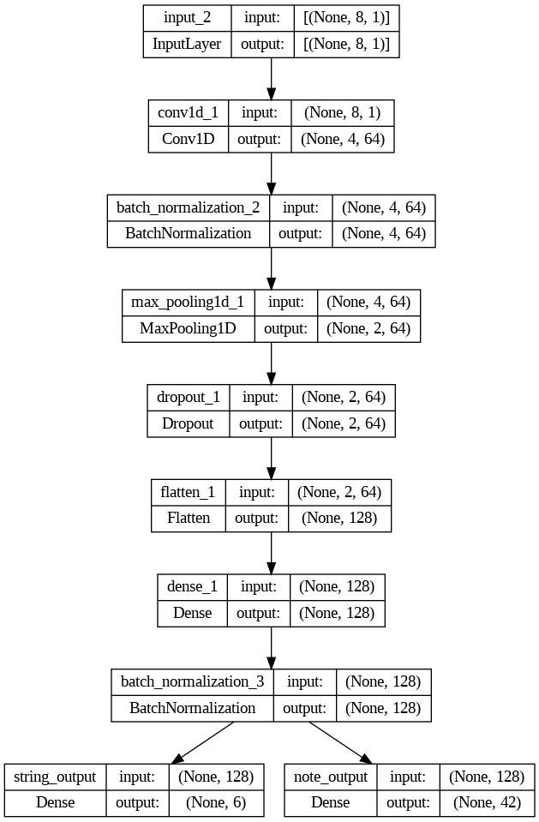
MODEL ARCHITECTURE

Slide 14
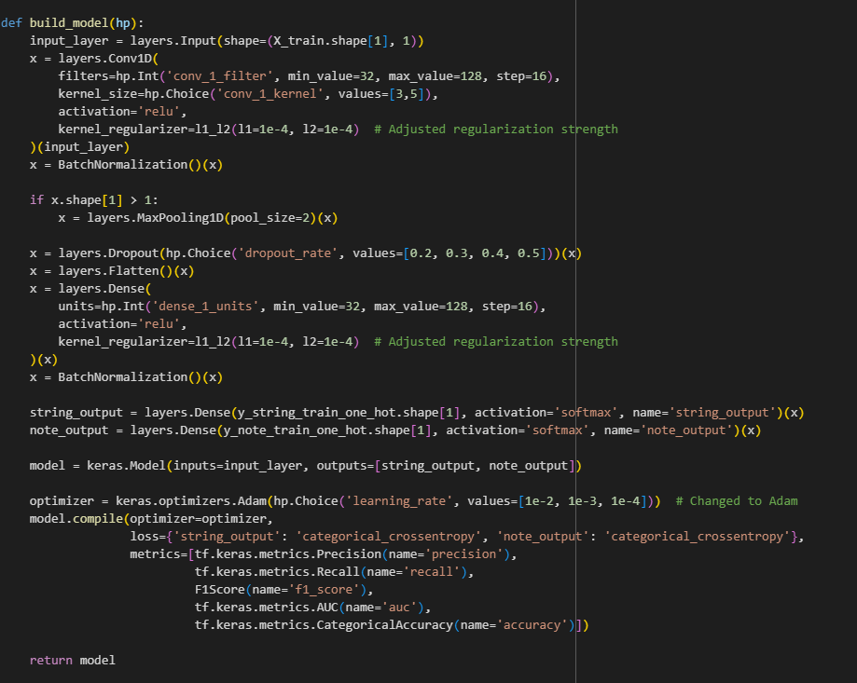
MODEL CODE DEMONSTRATION

Slide 15
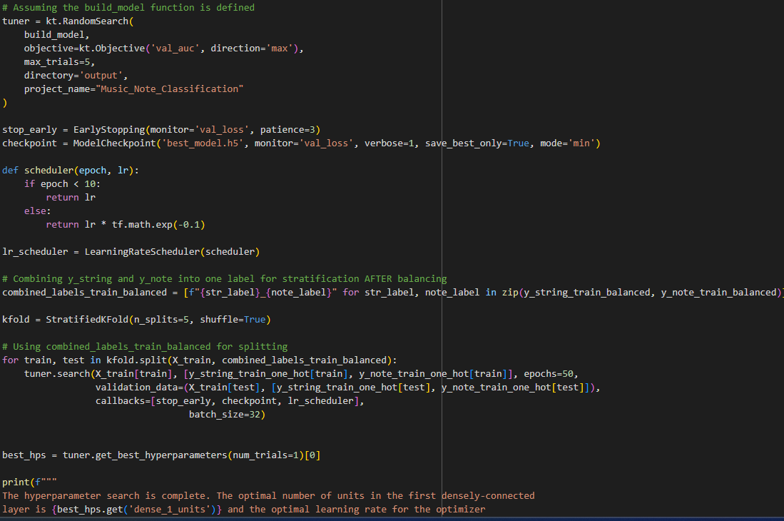
HYPERPARAMETER CODE DEMONSTRATION

Slide 16
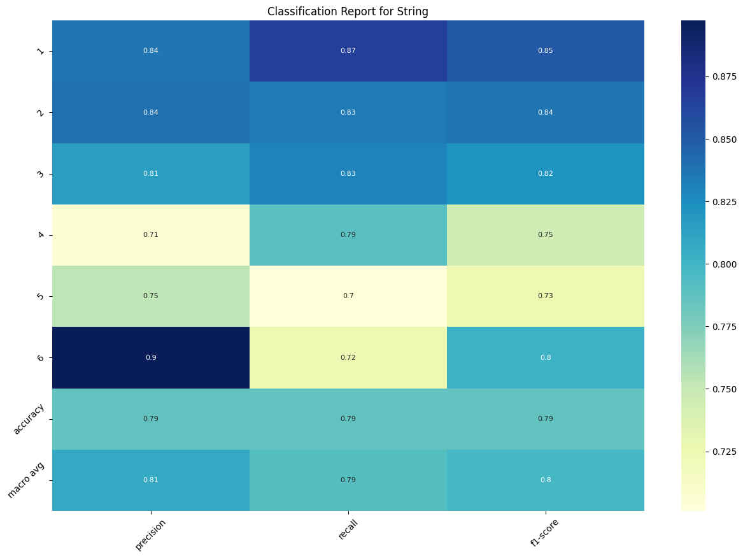
MODEL EVALUATION
Classification report with metrics such as Loss, Precision, Recall, F1 score, and AUC to understand model performance and areas of improvement.

Slide 17
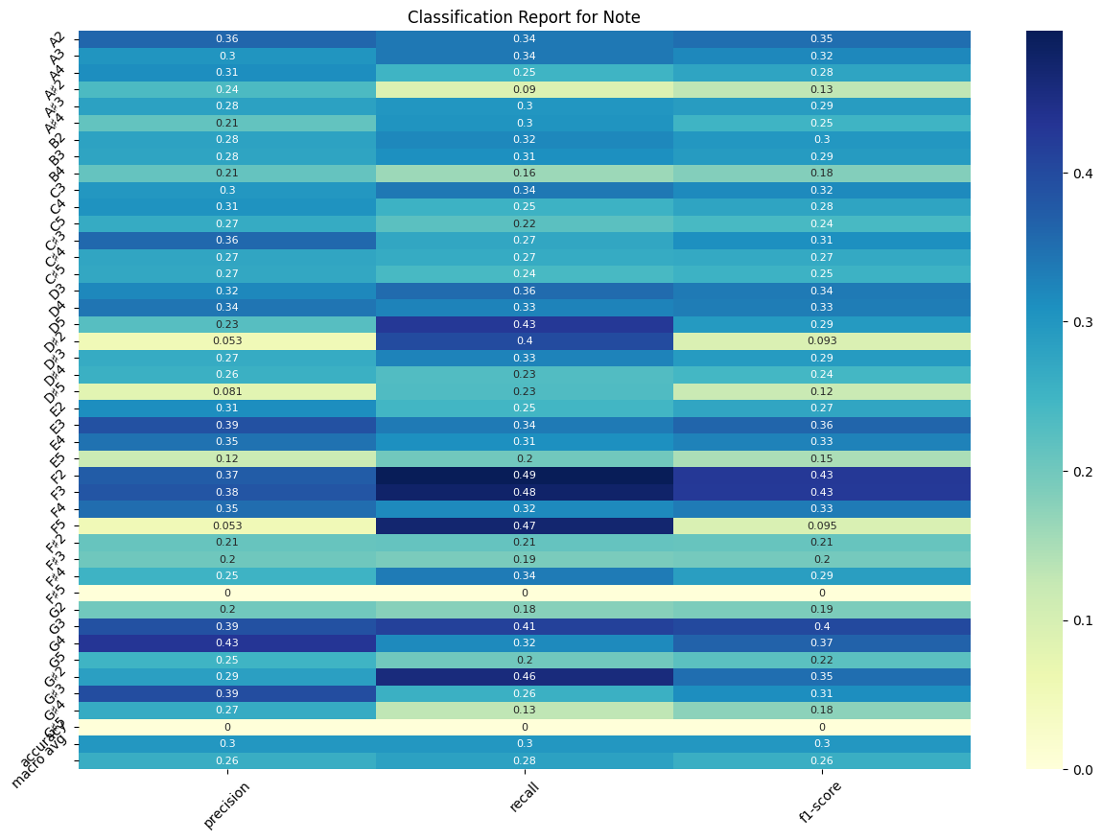

Slide 18
CONCLUSION
A Convolutional Neural Network (CNN) was employed for monophonic guitar note and string classification.
The model showed promising results in string classification, achieving an accuracy of 78.63%.
Note classification presented challenges, with significant variations in performance across different classes.
The study identified potential areas for improvement and suggested exploring different neural network architectures and more sophisticated noise handling techniques, contributing valuable insights to the field of audio signal processing.

Slide 19
THANK YOU

